Slide 1

DEPARTMENT OF COMPUTER SCIENCE AND ENGINEERING
2024-24
PROJECT ON
“TITLE: Running GenAI on Intel AI Laptops and Simple LLM Inference on CPU and fine-tuning of LLM Models using Intel® OpenVINO™ ”
“SUBTITLE: Medical And Drug Assistant Chatbot”
PRESENTED BY
Mr. Atharva Prakash Pawar.
Miss. Ankita Kiran Phalke. Miss. Sonali Madhukar Lokare.

Slide 2
Problem Statement
"Running GenAI on Intel AI Laptops and Simple LLM Inference on CPU and fine-tuning of LLM Models using Intel® OpenVINO™"
Our goal is to harness the capabilities of Intel AI Laptops and Intel® OpenVINO™ to run Generative AI (GenAI) models and perform large language model (LLM) inference on CPU. This enables efficient fine-tuning of LLMs for practical applications. We aim to demonstrate this through the development of a Medical and Drug Assistant Chatbot, providing real-time medical advice and drug information.

Slide 3
Unique Idea Brief(Solution)
Medical and Drug Assistant Chatbot:
We have developed a Medical and Drug Assistant Chatbot using the Intel® OpenVINO™ toolkit to optimize LLMs for CPU-based inference on Intel AI Laptops. This chatbot is designed to offer real-time medical and drug information, providing users with accurate and personalized advice. By leveraging the efficiency of Intel® OpenVINO™, we ensure that the model runs effectively on CPU, making it accessible and cost-effective.
Key Objectives:
Utilize Intel AI laptops to demonstrate the capability of running complex AI models efficiently.
Implement Intel® OpenVINO™ for optimizing LLM inference, reducing the need for expensive GPU resources.
Provide a practical and user-friendly solution for accessing reliable medical and drug information.

Slide 4
Features Offered
Medical Advice:
The chatbot provides detailed information on various medical conditions, symptoms, and potential treatments, helping users understand their health issues better.
Drug Information:
Users can receive comprehensive details about different medications, including their uses, dosage, side effects, and potential drug interactions, ensuring informed decisions about their treatment options.
Personalized Recommendations:
By analyzing user-specific data and medical history, the chatbot offers personalized medical advice and drug recommendations, enhancing the relevance and accuracy of the information provided.

Slide 5
Real-Time Responses:
The chatbot is designed to deliver fast and accurate responses, ensuring a seamless user experience. This is achieved through the efficient processing capabilities of Intel AI laptops and the optimization provided by Intel® OpenVINO™.
User-Friendly Interface:
The chatbot is developed using Streamlit for ease of use on both web and mobile platforms, featuring an intuitive and easy-to-use interface that ensures users can interact with it effortlessly.
Data Privacy:
Ensuring the security and confidentiality of user data is a top priority. The chatbot is designed to handle sensitive medical information securely, adhering to relevant privacy regulations and best practices.

Slide 6
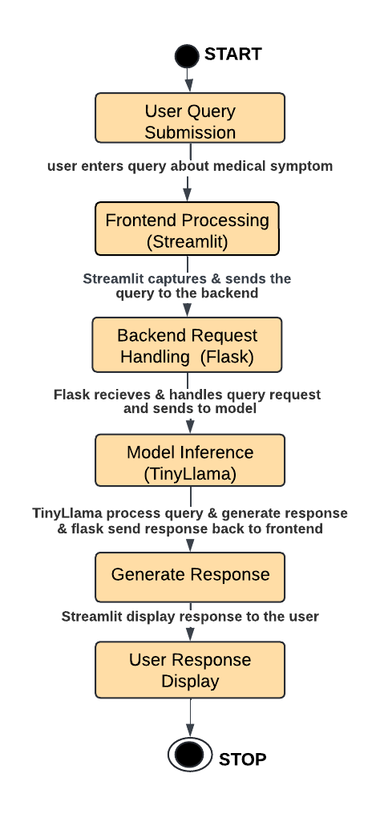
Process Flow

Slide 7
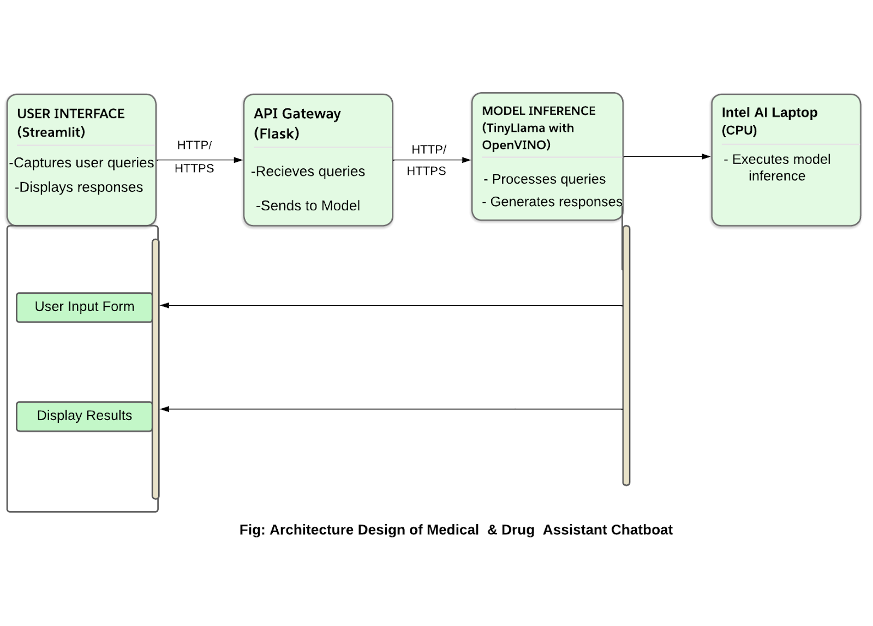
Architecture Diagram

Slide 8
Technologies used
Frontend Technology: Streamlit
Streamlit is an open-source app framework for creating and sharing beautiful, custom web apps for machine learning and data science. It allows for the rapid development of interactive web applications and data visualizations, making it easy to create a user-friendly interface for our Medical and Drug Assistant Chatbot.
2.BackendTechnology: Flask
Flask is a lightweight WSGI web application framework in Python. It is designed with simplicity and flexibility in mind, allowing developers to create robust backend services with minimal setup. Flask is used to handle the server-side logic and manage communication between the frontend and the machine learning model.
3.Model Used: TinyLlama, fine-tuned for specific tasks
TinyLlama is a compact version of the LLaMA (Large Language Model) designed to perform natural language processing tasks efficiently. In our project, TinyLlama has been fine-tuned to provide accurate medical advice and drug information, ensuring that the chatbot can respond appropriately to user queries.

Slide 9
4.Optimization: Intel® OpenVINO™ for efficient CPU-based inference
Intel® OpenVINO™ (Open Visual Inference and Neural Network Optimization) toolkit is designed to optimize and deploy AI inference at the edge. By using OpenVINO™, we can accelerate the inference process on Intel hardware, specifically enabling our model to run efficiently on CPUs. This ensures that our chatbot delivers fast and reliable responses without the need for expensive GPU resources.
5. Hardware: Intel AI Laptops, providing the necessary computational power for real-time model inference
Intel AI Laptops are equipped with advanced processors and optimized for AI workloads. These laptops provide the computational power needed to run our optimized Tinyllama model in real-time, ensuring that the chatbot can process and respond to user queries quickly and accurately.
These technologies work together to create a robust, efficient, and user-friendly Medical and Drug Assistant Chatbot capable of providing timely and accurate information to users.

Slide 10
Team members and contribution:
Atharva Pawar:
Developed the Flask backend and integrated the TinyLlama model with Intel® OpenVINO™. Designed and implemented the Streamlit interface. Fine-tuned the TinyLlama model and optimized it with Intel® OpenVINO™.
Ankita Phalke:
Conducted system testing and ensured performance standards. Prepared user guides, technical reports, and the final presentation. Designed the system architecture and ensured scalability.
3. Sonali Lokare:
Collected and preprocessed data, and contributed to model training. Coordinated project activities and managed communication. Implemented security measures and ensured data protection compliance.
1

Slide 11
Conclusion
The Medical and Drug Assistant Chatbot showcases the powerful capabilities of Intel® OpenVINO™ and fine-tuned language models (LLMs) in providing reliable, real-time medical advice and drug information. Running on Intel AI laptops and utilizing CPU-based inference, this solution is both cost-effective and accessible, making it a practical tool for users seeking medical assistance.
This project demonstrates the potential of Intel’s AI technologies to revolutionize healthcare applications, offering significant benefits to users and healthcare providers. With efficient processing, personalized recommendations, and a user-friendly interface, our chatbot sets a new standard for digital health solutions.
By leveraging advanced AI and optimized hardware, the chatbot ensures quick and accurate responses, enhancing user experience and trust. The integration of Streamlit for the front end and Flask for the back end provides a seamless interaction platform, while the TinyLlama model, optimized with OpenVINO, ensures efficient inference on standard CPUs, making advanced AI accessible to a broader audience. This project exemplifies the future of digital healthcare, where technology and AI play a pivotal role in delivering personalized and immediate medical assistance.

